Slide 1
M5
Project Procurement Management Contracting and
Outsourcing

Slide 2

Project Procurement Management
Is one of the nine PMBOK areas
Focuses on the acquisition and management of outside products and services
Project teams require resources and many of these resources must be acquired externally
  e.g., office supplies, technology, printing services, etc.
Organizations can also outsource entire business functions and business processes
  e.g., data centers, call centers, accounting functions, and projects
Outsourcing was commonly called “subcontracting”
Project teams can be outsourcing buyers and sellers

Slide 3
Project Procurement Management PMBOK Definition:
The contract management and change control processes are required to administer contracts or purchase orders issued by authorized project team members. Project Procurement Management also includes administering any contract issued by an outside organization (the buyer) that is acquiring the project from the performing organization (the seller), and administering contractual obligations placed on the project team by the contract.

Slide 4
Six Main Processes of Project Procurement
  Planning purchases and acquisition.
  Planning contracting.
  Requesting seller Responses.
  Selecting Sellers
  Administrating the contracts.
  Closing the contract.

Slide 5
Summary of Project Procurement Processes
Plan Purchases and Acquisitions | Making the decision as to what will be purchased or acquired as well as determining the logistics of when purchases will be made and how.
Plan Contracting | Documenting the product, services, or results needed as well as identifying potential sellers, vendors, suppliers, contractors, subcontractors, or other service providers.
Request Seller Responses | Obtaining bids, quotes, proposals, literature, and other information from potential sellers or service providers.
Select Sellers | Negotiating, selecting, and contracting with a seller for a particular product or service.
Contract Administration | Managing the relationship and contract between the buyer and seller. This includes reviewing and documenting the seller’s performance, contract changes, and taking corrective action when necessary.
Contract Closure | Completing and settling each contract after any open items or settlements are resolved.

Slide 6
Project Procurement Processes
1.Plan Purchases and Acquisition
Begins by determining which project needs can be fulfilled internally by the project team
  Which can be best fulfilled externally?
Focuses not only what can best be filled internally or externally, but
  How
  When
  How Many
  And Where these products or services will be acquired

Slide 7
Project Procurement Processes
Plan Purchases and Acquisition
The decision depends on
  The project scope
  Availability of the products and services in the marketplace
  Cost
  Quality
  Terms and Conditions
  Experience and skills of the project team
Similar to a “make” or “buy” decision

Slide 8
Project Procurement Processes
Plan Purchases and Acquisition
“Make” or “Buy” Decision
  Can use the tools that were used to evaluate alternatives
    Payback
    ROI
    Net Present Value
    Scoring Model
  The risk management approach could also be used
    Risks can be identified and assessed so that an appropriate risk strategy can be formulated

Slide 9
Contract Statement of Work
The statement of work (SOW) is a description of the work required for the procurement.
Basic outline or template for SOW is as below:
STATEMENT OF WORK (SOW)
Scope of Work: Describes the work to be done in detail. Specify H/W and S/W involved and exact nature of work.
Location of Work: Describes where the work must be performed. Specify location of hardware and software and where the people must perform the work.
Period of Performance: Specify when the work is expected to start and end, working hours, where the work must be performed.
Deliverables Schedule: List specific deliverables, describe them in detail and specify when they are due.
Applicable Standards: Specify any company or industry specific standards that are relevant to performing the work.
Acceptance Criteria: Describes how the buyer organization will determine if the work is acceptable.
Special Requirements: Specify any special requirements such as h/w and s/w certifications, minimum degree or experience level of personnel, travel requirements and so on.

Slide 10
Project Procurement Processes
2. Plan Contracting
Focuses on developing a procurement document such as a request for proposal that can be used to solicit bids, quotes, or proposal from prospective sellers
A common set of measures should be used to compare and evaluate various proposals from sellers
Also includes the development of criteria for evaluating sellers’ proposals
  For example, this may include the seller’s expertise, experience, capability, and references

Slide 11
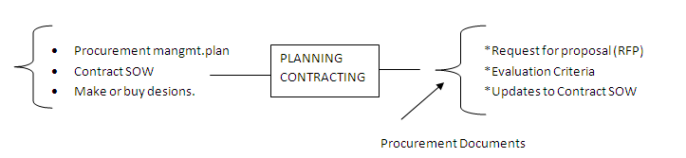
Planning Contracting:
Planning contracting involves preparing the documents needed for potential sellers to prepare their responses and determining the evaluation criteria for the contract award.
The procurement management plans, contract statement of work, make-or-buy decisions, are all important inputs for this process.
The project team often uses the standard form and expert judgment as tools to help them create relevant procurement documents and evaluation criteria.
Two common examples of procurement documents include:
Request for Proposal (RFP)
Request for Quote (RFQ)

Slide 12
Request for Proposal (RFP)
RFP is a document used to solicit bids , quotes or proposals from prospective sellers.
A proposal is a document prepared by a seller when there are different approaches for meeting buyer needs.
Example: If an organization wants to automate its work practices or find a solution to business problem, it can write and issue an RFP, so suppliers can respond with proposals.
Suppliers might propose various hardware, software and networking solutions to meet the organizations need.

Slide 13
Request for Quote (RFQ)
It is a document used to solicit quotes or bids from perspective suppliers.
A bid, also called tender or quote (quotation) is a document prepared by seller providing pricing for standard items that have been clearly defined by the buyer.
Example: If a company wanted to purchase 100 personal computers with specific features, it might issue an RFQ to potential suppliers.
Selections are often made based on the lowest price bid.

Slide 14
Project Procurement Processes
3.Request Seller Responses
After planning for contracting, the next procurement management process involves:
    Deciding whom to ask to do the work
    Sending appropriate documentation to the potential sellers
    Obtaining proposals or bids.
The buyer should strive to receive a reasonable number of high-quality, competitive proposals
Buyers let prospective sellers know that requests or bids are being sought by
  Holding conferences with prospective sellers so they have a clear idea of what the buyer needs
  Advertising in newspapers, trade journals, or the Web
  Contacting a potential seller directly

Slide 15
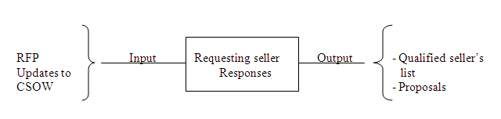
O/P of Requesting Seller Response
The seller’s proposal should include not only the price for the product or service, but also the seller’s ability and willingness to provide what is requested

Slide 16
Project Procurement Processes
4.Selecting Sellers
After bids, proposals, or quotations are received, the buying organization must select a seller
The criteria used in the Plan Purchases and Acquisition process should be used
Although price or cost may be an important criteria, other criteria should be considered as well

Slide 17
Selecting Sellers
Criteria |  | Proposal 1 | Proposal 2 | Proposal 3 etc
 | Weight | Rating score | Rating score | Rating score
Technical Approach | 30%
Management Approach | 30%
Past Performance | 20%
Price | 20%
Total | 100%

Slide 18
Project Procurement Processes
Selecting Sellers
Once a seller is selected, the buyer and seller enter into a contract that defines the terms and conditions of the buyer-seller relationship
A contract is a document signed by the buyer and seller as a legally binding agreement that obligates seller to provide specific products, services, or results, while obligating the buyer to provide specific monetary or other consideration

Slide 19
Categories for Procurement-Type Contracts
  Different types of contracts can be used in different situations.
  Three broad categories of contracts are:
        Fixed price or lump-sum contracts.
        Cost reimbursable contracts.
        Time and material contracts.
1. Fixed-Price or Lump-Sum Contracts
  A total or fixed price is negotiated or set as the final price for a product or service
  May include incentives for meeting certain performance objectives or penalties if those objectives are not met

Slide 20
Categories for Procurement-Type Contracts
2.Cost-Reimbursable Contracts(CRC)
  Payment or reimbursement is made to the seller to cover the seller’s actual direct costs (i.e., labor, materials, etc.) and indirect costs (i.e., admin. salaries, rent, utilities, etc.)
  May include incentives for meeting certain objectives or penalties if those objectives are not met
  Types of CRC
    Cost-Plus- Fee (CPF) or Cost-Plus-Percentage (CPPC)
    Cost-Plus-Fixed-Fee (CPFF)
    Cost-Plus-Incentive-Fee (CPIF)

Slide 21
Types of Cost-Reimbursable Contracts
Cost-Plus-Fee (CPF) or Cost-Plus-Percentage Cost (CPPC)
  The seller is paid for the costs incurred in performing the work as well as a fee based upon an agreed on percentage of the costs
Cost-Plus-Fixed-Fee (CPFF)
  The seller is reimbursed for the total direct and indirect costs of doing the work, but receives a fixed amount that does not change unless the project’s scope changes
Cost-Plus-Incentive-Fee (CPIF)
  The seller is reimbursed for the costs incurred in doing the work and receives a predetermined fee plus an incentive bonus for meeting certain objectives

Slide 22
Categories for Procurement-Type Contracts
3.Time and Materials (T&M) Contracts
  A hybrid of cost-reimbursable and fixed-price contracts
  The buyer pays the seller for both the time and materials required to complete the work.
    Resembles a cost-reimbursable contract because it is open-ended and full cost of project is not predetermined
    But can resemble a fixed-price contract if unit rates are set

Slide 23
Project Procurement Processes
5.Administrating the contracts
A signed contract means that the buyer and seller have entered into a relationship where both parties must fulfill their contractual obligations
The contract administration process ensures that both parties are performing in accordance to the terms of the contract

Slide 24
Contract Administration Includes:
Authorizing and coordinating the contracted work at the appropriate time
Monitoring the contractor’s performance with respect to scope, schedule, budget, and quality
Managing the scope in terms of its definition and change control
Risk identification, assessment, and control
Monitoring that all payments, as stipulated in the contract, are made
Reviewing and evaluating the seller’s performance both in terms of fulfilling contract obligations, but also the seller’s response when problems arise and require corrective action
Determining whether the contract needs to be amended
Deciding if the contract should be terminated early for just cause, convenience, or when the seller is in default

Slide 25
Project Procurement Processes
6.Contract Closure
Focuses on verifying that all of the work outlined in the contract is finished
Also includes updating records to reflect the final results, archiving information for future use, and other administrative activities
Results when the buyer and seller mutually agree that the obligations of the contract have been fulfilled
However, early termination of the contract can occur if one party is unable to fulfill their obligations
Regardless whether a contract is closed as planned or prematurely, lessons learned should be documented so that best practices can be identified

Slide 26



Slide 27
Outsourcing
Is the procurement of products or services from an external vendor, supplier, or manufacturer
  In this respect, outsourcing is similar to project procurement management
However, outsourcing provides more of a strategic approach, while project procurement management is more tactical

Slide 28
Why Outsourcing???
Many information technology projects involve the use of goods & services from outside the organization.
Most organization do use some form of outsourcing to meet their information technology needs.
Companies can use outsourcing to reduce labors costs on projects by avoiding the cost of hiring, firing, and reassigning people to projects or paying their salaries when they are between projects.
By outsourcing many information technology functions, employees can focus on jobs that are critical to the success of the organization.

Slide 29
Access skills and technologies: Organization can gain access to specific skills and technologies when they are required by using outside resources.
Provide Flexibility: Outsourcing to provide extra staff during period of peak workloads can be much more economical than trying to staff entire projects with internal resource.
Increase accountability: A well-written contract can clarify responsibilities and sharpen focus on key deliverables of project. Because contracts are legally binding, there is more accountability for delivering the work as stated in the contract.

Slide 30
The Outsourcing Phenomenon
Really started in 1989 when Eastman Kodak Company in Rochester, NY signed a 10-year, $250 million deal to outsource its entire IT function to IBM
  Within 1 year, Kodak’s costs decreased almost 95%, PC support costs dropped to about 5-10%, while mainframe costs also were reduced by 10-15%
Kodak was not the first or the largest company to turn to outsourcing, but it was the first well-known and successful company to outsource an entire IT function
Subsequently, other companies began questioning whether they had to provide their own IT services and began talking about core competencies, cost savings, and strategic partnerships with IT vendors
By the year 2000, IT came to a crossroads when more than 54% of IT services purchased in North America were outsourced
Momentum is expected to continue in the U.S. and Europe

Slide 31
Types of Outsourcing Relationships
Business Process Outsourcing
  Where an organization turns over processes other than just IT
    E.g., Accounting, Human Resources, R&D, etc.
Offshoring
  Outsourcing to another country usually overseas in order to take advantage of labor arbitrage (cheaper labor)

Slide 32
Approaches to Outsourcing
Just as an organization can pursue outsourcing as a strategic approach, so too can a project manager and team in terms of
  Full-Insourcing
    The organization or project develops all products and services internally
  Full-Outsourcing
    All products and services are acquired from external sources
  Selective Outsourcing
    Perhaps the best approach because it provides greater flexibility in choosing which processes or deliverables should be outsourced and which should be kept internal

Slide 33

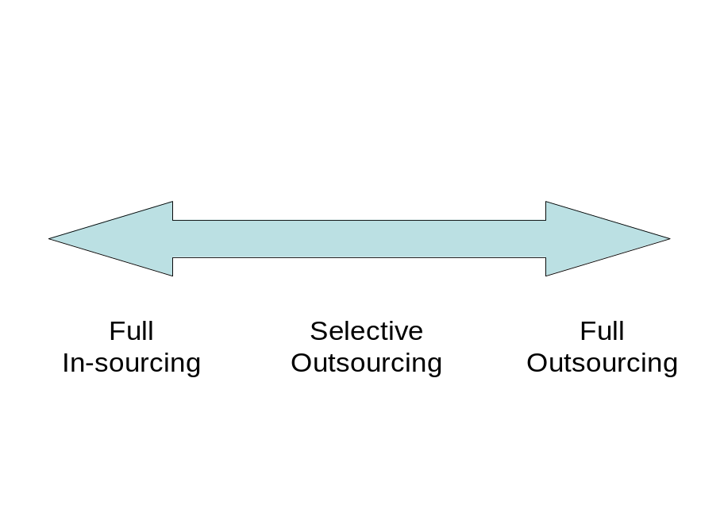
The project team
is responsible
for all project
processes &
delivery of
the project’s scope
All of the project
processes &
delivery of
the project’s scope
is the responsibility
of external sources
Provides the most flexibility
because some project
processes and scope
are done internally by
the project team, while
others are outsourced
externally.
Figure 12.1

Slide 34
Realities of Outsourcing
Before the Kodak deal, outsourcing was not a controversial topic, especially by IT professionals
Controversy centers on offshoring, or the perception that jobs within one country are replaced by lower-wage jobs in another
  Many believe that domestic unemployment increases and negatively impacts the economy
  By 2015, US companies will shift 3.3 million service jobs to lower wage countries; approx 8% from IT sector.

Slide 35
Realities of Outsourcing
Others believe that although some people lose their jobs because of outsourcing, many new, higher paying jobs are often created
Organizational change management plays an important role in successful outsourcing relationships
However, according to Peter F. Drucker (2002), if developing people is the most important task in business, then the trend towards outsourcing can reduce an organization’s ability to gain competitive advantage in a knowledge economy

Slide 36
Managing the Outsourcing Relationship
A study by Deloitte Consulting reports that 70% of 25 large organizations that took part in a survey reported negative experiences with outsourced projects and that a number of these companies are starting to bring projects back in-house
Outsourcing is itself a project so following a project management approach makes sense for improving the likelihood of success

Slide 37
7 Deadly Sins of Outsourcing Activities and Projects
Outsourcing activities that should not be outsourced
Selecting the wrong vendor
Writing a poor contract
Overlooking personnel issues
Losing control over the outsourced activity
Overlooking the hidden costs of outsourcing
Failing to plan an exit strategy

Slide 38
THE END

